Slide 1
CAPSTONE PROJECT
MEDICATION ADHERENCE TRACKER
Presented By:
Student Name-Harshitha Adepu
College Name-Sridevi Women’s Engineering College
Department-Computer Science & Engineering (CSE)
AICTE ID-STU681f5c6e3b9ea1746885742

Slide 2
OUTLINE
Problem Statement (Should not include solution)
Proposed System/Solution
System Development Approach (Technology Used)
Algorithm & Deployment
Result
Conclusion
Future Scope
References

Slide 3
PROBLEM STATEMENT
Chronic disease patients, such as those with diabetes and hypertension, often forget or miss their prescribed medication doses. Poor medication adherence can lead to worsening health conditions, serious complications, and increased healthcare costs. At the same time, caregivers and doctors have limited visibility into whether patients are taking their medications as prescribed, making it difficult to identify missed doses and declining adherence at an early stage. This lack of consistent medication management and monitoring can negatively affect treatment outcomes and patient safety.

Slide 4
PROPOSED SOLUTION
The proposed system is a Medication Adherence Tracker designed to help chronic disease patients take their medications on time and enable authorized caregivers and doctors to monitor their adherence.
The system will provide a patient-facing application where users can add medication details such as medicine name, dosage, frequency, and duration. Patients can record each dose as Taken, Missed, or Skipped and receive reminders at scheduled times.
A caregiver/doctor dashboard will provide authorized users with real-time visibility into a patient's medication adherence. The system will calculate adherence percentages and display weekly and monthly trend charts to identify changes in medication-taking behavior.
The system will also generate automatic alerts when adherence falls below a configurable threshold. A consent-based linking mechanism will ensure that patient information is shared only with approved caregivers or doctors.
The solution will support offline medication logging with synchronization when connectivity is restored, making it suitable for mobile use. Overall, the system aims to improve medication adherence, provide better monitoring, and support timely intervention by caregivers and healthcare professionals.

Slide 5
SYSTEM APPROACH
The System Approach outlines the overall strategy and methodology for developing and implementing the Medication Adherence Tracker. The system focuses on medication scheduling, intake logging, reminders, adherence analysis, and monitoring by authorized caregivers or doctors.
System Requirements Hardware Requirements
Smartphone for patients
Computer/Laptop for caregivers and doctors
Server: 2 vCPU, 4 GB RAM
Internet connection for synchronization and notifications
Software Requirements
Operating System: Windows/Linux/Android
Frontend: React.js / React Native
Backend: Python with FastAPI
Database: PostgreSQL
Web Browser: Chrome/Edge/Firefox
Code Editor: VS Code
API Testing: Postman

Slide 6
ALGORITHM & DEPLOYMENT
Algorithm Selection:
Use a Rule-Based Adherence Analysis Algorithm to calculate medication adherence and identify patients at risk. It is suitable because the system mainly works with scheduled doses and medication intake records.
Data Input:
Medication name, dosage & frequency
Scheduled medication times
Taken / Missed / Skipped status
Daily and historical intake records
Adherence threshold
Training/Processing:
No machine learning training is required. The system processes medication logs and calculates:
Adherence % = (Taken Doses / Expected Doses) × 100
Prediction/Alert Process:
The system continuously compares the calculated adherence with the configured threshold. If adherence falls below the
threshold, an automatic alert is generated for the authorized caregiver/doctor and displayed on the dashboard.

Slide 7
RESULT
Since the Medication Adherence Tracker uses a rule-based adherence algorithm rather than machine learning, model accuracy is not applicable.
Adherence Accuracy: Calculated directly from medication intake records.
Effectiveness: Identifies missed/skipped doses and low-adherence patients.
Performance Metrics: Daily, weekly, and monthly adherence percentage.
Visualization: Line charts show adherence trends over time.
Comparison: Expected doses are compared with actual Taken, Missed, and Skipped doses.
Alerts: Caregivers/doctors are notified when adherence falls below the configured threshold.
Example: If 90 out of 100 expected doses are taken, the system reports 90% adherence and compares it against the selected threshold.

Slide 8
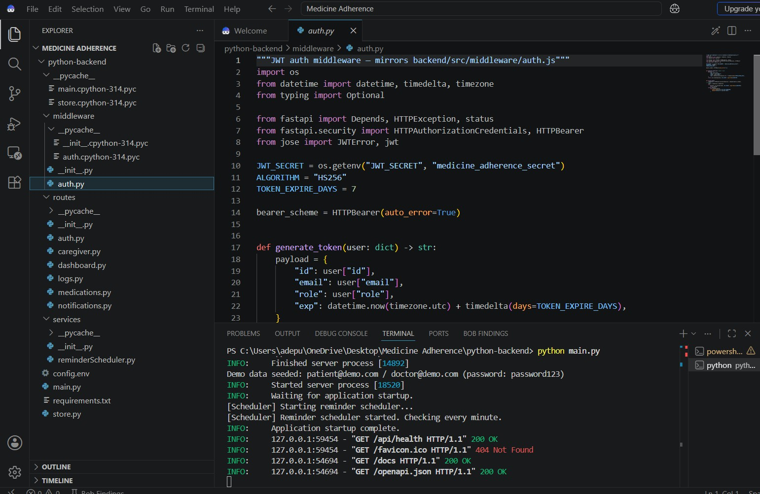
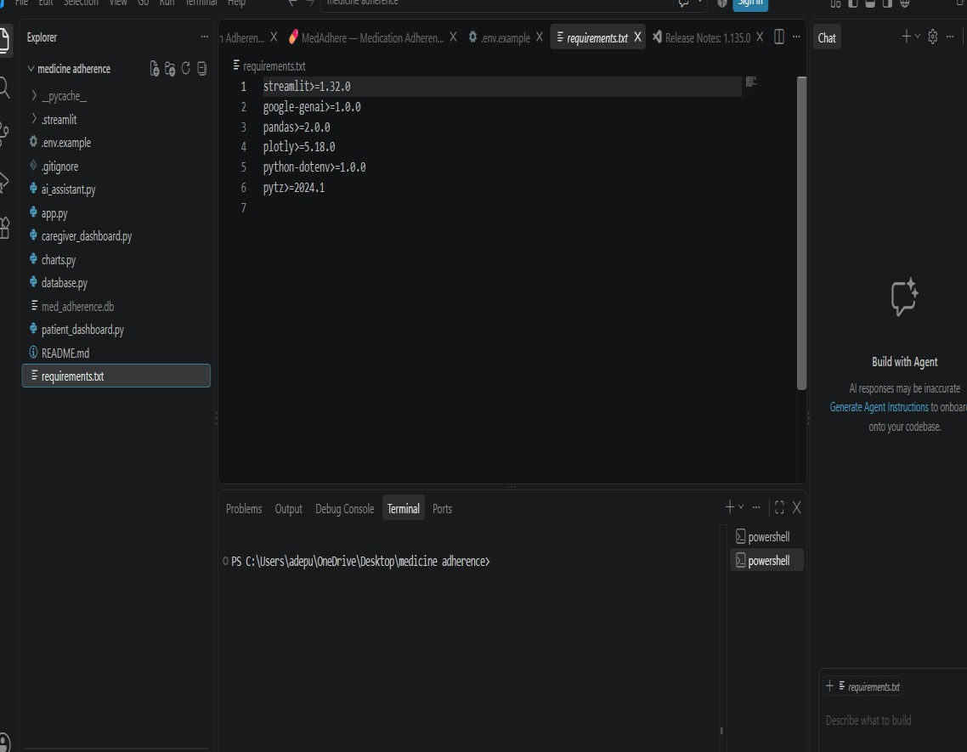

Slide 9
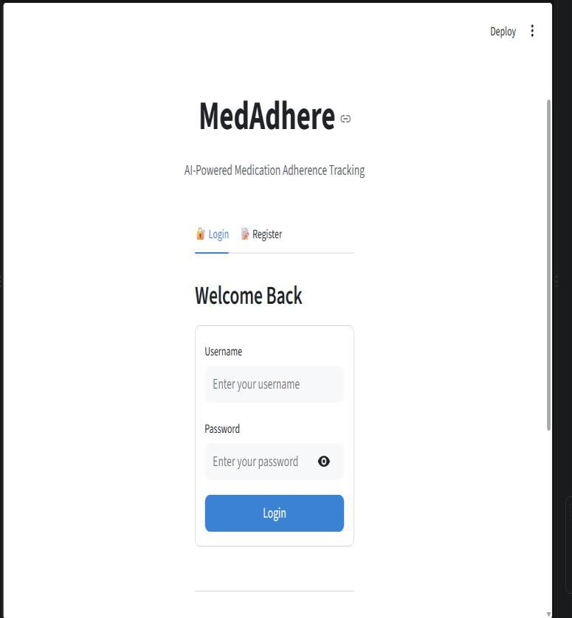
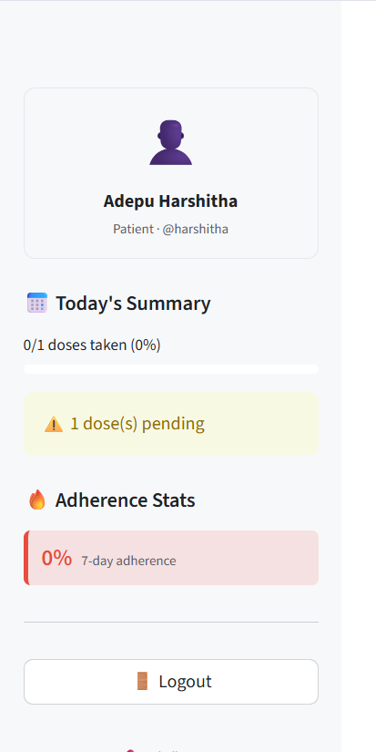
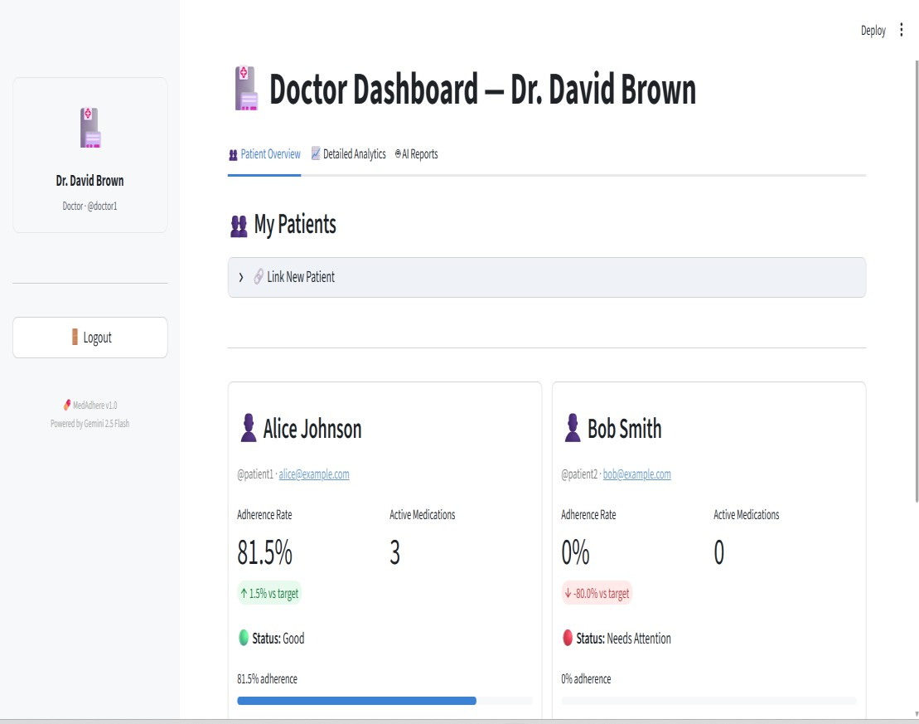

Slide 10
CONCLUSION
The Medication Adherence Tracker effectively helps patients manage their medications through personalized schedules, timely reminders, and intake logging, reducing the chances of missed or incorrect doses. It also enables caregivers and doctors to monitor medication adherence through dashboards, charts, and alerts, allowing them to identify problems early and provide timely support. The key benefits of the tracker include improved medication adherence, better patient safety, reduced missed doses, easy monitoring, improved communication between patients and caregivers, and more informed healthcare decisions. However, the system faces challenges such as ensuring reliable notifications, synchronizing data accurately during offline periods, and maintaining secure patient-caregiver linking to protect sensitive information.

Slide 11
FUTURE SCOPE
Integrate AI/ML to predict medication non-adherence and identify high-risk patients.
Add voice assistants and chatbots for medication guidance and reminders.
Integrate smartwatches and IoT devices to collect real-time health data.
Use advanced analytics to provide personalized adherence recommendations.
Add mobile push notifications and SMS/WhatsApp reminders.
Enable integration with Electronic Health Records (EHRs) for better clinical monitoring.
Improve offline synchronization and real-time data updates.
Expand the system to support multiple chronic diseases and languages.
Strengthen security using encryption and advanced authentication.

Slide 12
REFERENCES
World Health Organization (WHO) – Adherence to Long-Term Therapies: Evidence for Action
NCBI / PubMed – Research articles on medication adherence and chronic disease management.
Firebase Documentation – Push notifications and real-time data synchronization.
FastAPI Documentation – Backend API development and implementation.
PostgreSQL Documentation – Database design and management.
GitHub – Source-code management and project development: GitHub
Python Documentation – Python Standard Library reference: Python Standard Library

Slide 13
DEPLOYMENT LINK / GITHUB LINK
Github Link: https://github.com/Adepuharshitha/medication-adherence-tracker
Deployment: Streamlit: https://medication-adherence-tracker-pteeho9tbrizgqrwlnm55t.streamlit.app/

Slide 14
THANK YOU

